Slide 1
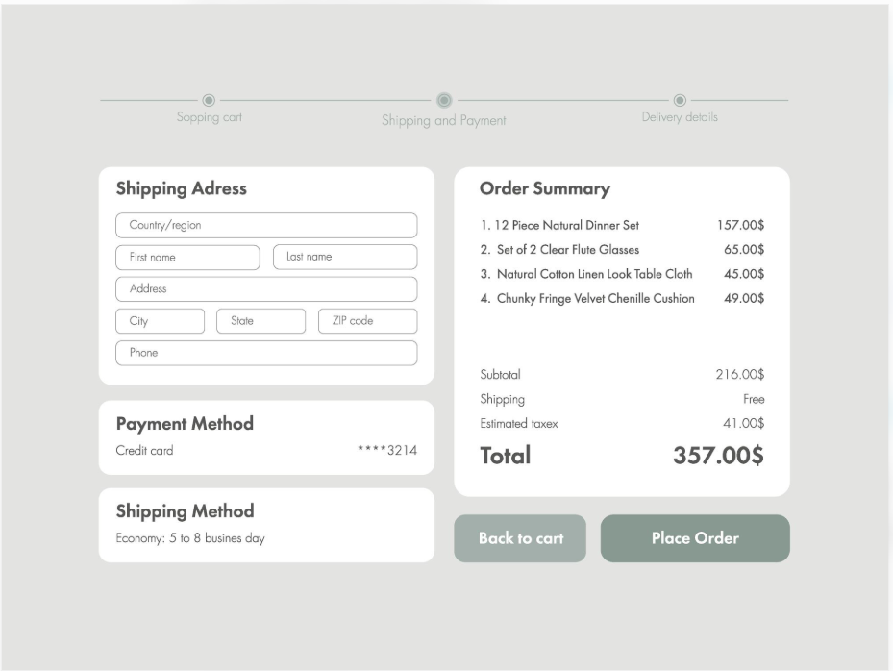
E-Commerce Checkout Page Redesign – A/B Testing
Business scenario: An e-commerce company wants to increase purchase conversion rates by redesigning its checkout page.
A - Control Group

Slide 2
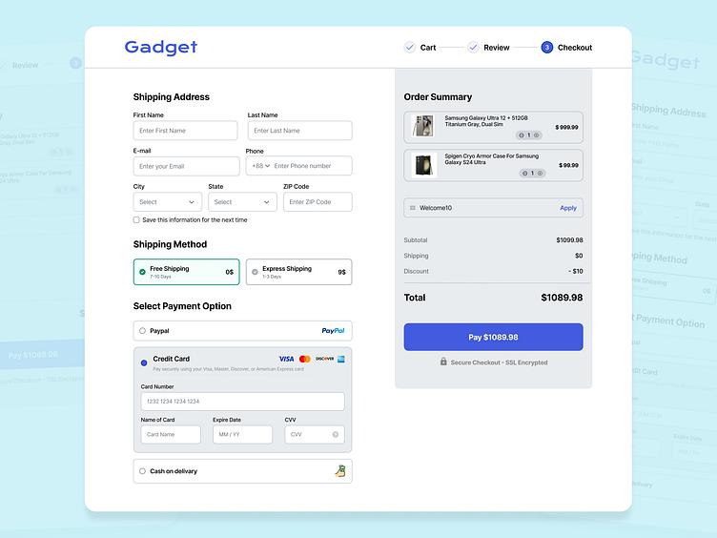
B – Treatment Group

Slide 3
Purchase Conversion Rate Experiment
Step 1. Define the objective and hypothesis
• Objective: Increase purchase conversion rate.
• Control (A): Existing checkout page.
• Variant (B): Redesigned checkout page.
• Primary metric: Purchase conversion rate = users who purchase ÷ eligible users exposed to the
checkout page.
• Guardrail metrics: Average order value, payment failure rate, checkout errors and complaint rate.
Hypotheses:
• Null hypothesis (H0)): The redesigned checkout page does not change the true purchase conversion
rate compared with the existing checkout page. H0, Conversion rate B = conversion rate A.
• Alternative hypothesis (H1): The redesigned checkout page changes the true purchase conversion rate
compared with the existing checkout page. H1, Conversion rate B ≠ conversion rate A.

Slide 4
Purchase Conversion Rate Experiment
Step 2. Set experiment parameters
Historical data shows a 5% purchase conversion rate.
Based on the A/B test sample calculator or Z test, two-proportion sample-size calculation requires approximately 8,158 users
per group (about 16,316 total) – minimum target users.
For the experiment analysis, 8,161 users per group (16,322 users in total) were considered, slightly exceeding the minimum required sample size
Parameter | Value
Baseline Conversion | 5%
Minimum Detectable Effect (MDE) | 1%
Significance Level (α) | 5%
Statistical Power | 80%
Allocation | 50% A / 50% B

Slide 5
Purchase Conversion Rate Experiment
Step 3. Run the experiment
• Randomly assign eligible users 50/50 to A or B.
• Keep each user's assigned version consistent.
• Run until the planned sample size and experiment duration are met.
• Validate tracking, randomization, and sample-ratio balance.
• Avoid stopping early just because results looks favourable.
Step 4. Analyze the results
The experiment completes with these results:
Metric | A : Existing | B : Redesigned
Users | 8,161 | 8,161
Purchases | 408 | 490
Conversion Rate | 5 % | 6%

Slide 6
Purchase Conversion Rate Experiment
Calculate the impact:
• Absolute lift: 6% − 5% = 1 percentage point
• Relative lift: (6% − 5%) ÷ 5% = 20%
• Pooled standard error (Z-test) = 0.0035695
• Statistical test: Two-proportion z-test (z-score: 2.8149)
• p-value: Approximately 0.00488 (Two Tailed)
• Standard error (CI) : 0.0035686
• Margin Error : 0.69945 pp
• 95% confidence interval for the lift: Approximately +0.3053 (lower bound) to +1.7042 (upper bound) percentage points.
• Since it’s entirely above zero, so the data support a positive improvement.
Since p-value (0.00488) is below α (0.05), & entire confidence interval was above zero, so result is statistically significant.

Slide 7
Purchase Conversion Rate Experiment
Interpretation
1. Version B achieved a conversion rate of 6.00%, compared to 5.00% for Version A.
2. The absolute lift was +1.0048 percentage points, indicating an improvement in the conversion rate.
3. The relative lift was +20.10%, meaning Version B generated approximately 20.10% more conversions relative to Version A.
4. The Z-score was 2.8149, indicating that the observed difference was approximately 2.81 standard errors away from zero.
5. The p-value was 0.00488, which is below the significance level (α = 0.05).
6. The 95% confidence interval ranged from +0.3053% to +1.7042%.
7. Since the entire confidence interval is above zero, the data support a positive improvement in Version B.
8. Since the p-value is below α (0.05) and the entire confidence interval is above zero, the result is statistically significant.

Slide 8
Purchase Conversion Rate Experiment
Recommendation
Before implementing the redesign across all users, monitor guardrail metrics such as Average Order Value, Payment Success Rate, Cart Abandonment Rate and Cancellation Rate.
Ensure that the improvement in conversion rate does not negatively affect the overall revenue, customer experience or payment performance.
If the conversion improvement remains consistent and guardrail metrics show no significant deterioration, recommend a gradual rollout of Version B to all users.
Continue monitoring performance after implementation to ensure that the improvement is sustained.

